Slide 1

TUTORIAL FOR ARDUINO UNO
TITTLE: ARDUINO DISTANCE MEASUREMENT

Slide 2
HOW PROJECT ABOUT?
In each sector, small requirements are essential for the development of major measures, including occurring new normal for today.

Slide 3
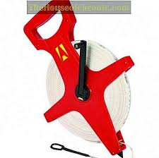
DEVELOPMENT WHEEL MEASUREMENT

Slide 4
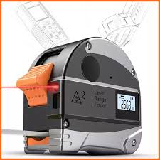
DEVELOPMENT ELECTRONIC MEASUREMENT

Slide 5
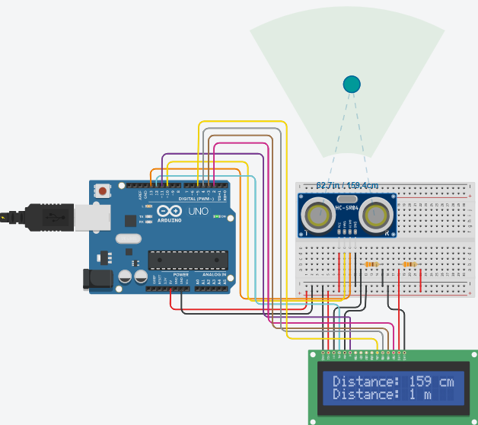
DEVELOPMENT ARDUINO DISTANCE MEASUREMENT

Slide 6
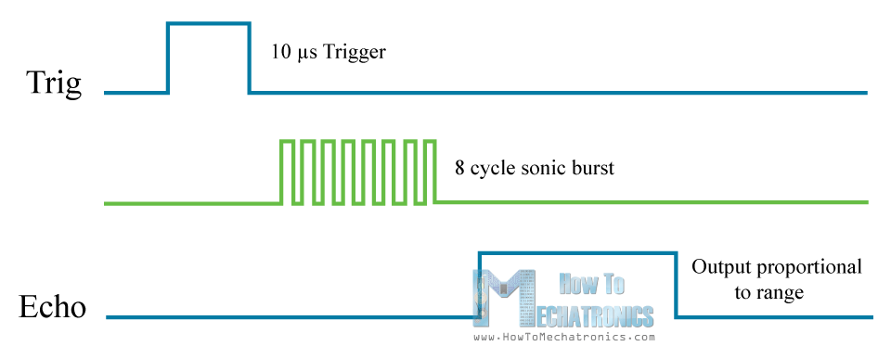
ABOUT ULTRASONIC
Trig setting to HIGH STATE
send out an 8-cycle sonic burst will travel at the speed sound.
Received sound speed

Slide 7

How to calculate?

Slide 8
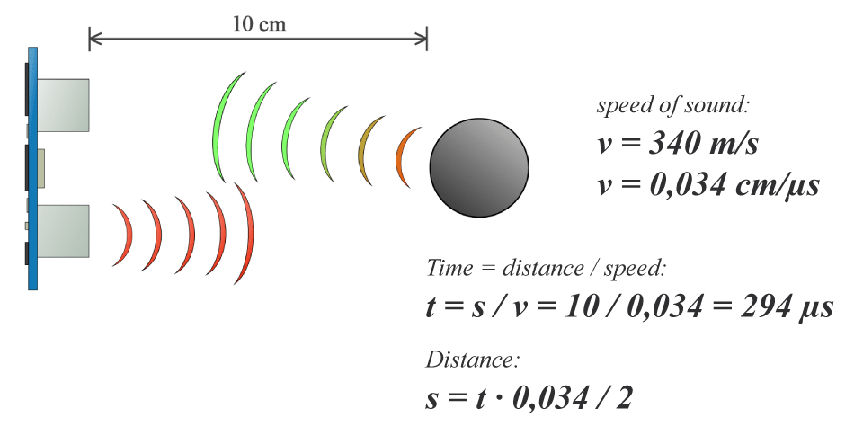
object is 10 cm away from the sensor.
sound wave will need to travel about 294 u seconds.
to get the distance in cm we need to multiply the received travel time value from the echo pin by 0.034 and divide it by 2.

Slide 9
TUTORIAL FOR ARDUINO UNO
THANK YOU FOR WATCHING

